Slide 1
A Data-Driven Insight to Enhancing Stress Management Through Chatbot Interaction Among Undergraduate Students
MD. Mohibur Zaman, MD. Rifat Rahman, Mehbub Shifat ur Rasul, MD Showrav Zaman, Mohyminul Islam Fahim
Department of Computer Science and Engineering, BRAC University, Dhaka, Bangladesh
{md.mohibur.zaman, md.rifat.rahman1, mehbub.shifat.ur.rasul, md.showrav.zaman,
mohyminul.islam.fahim}@g.bracu.ac.bd
Paper ID: 252
Presented By: MD. Mohibur Zaman

Slide 2

Stress management
Stress management involves techniques to reduce stress's negative effects and improve physical and mental health.

Slide 3
Background and Motivations
Students often face stress from academics, finances, and social pressures.
Unmanaged stress impacts harms grades, mental health and can lead to depression.
Counseling and self-help resources are often inaccessible.
Online tools offer support but lack personalization and are often not free.
Use data-driven methods for insights and interventions.
Deploy chatbots for personalized, scalable mental health support.

Slide 4
Related Works
Technology Intervention for Mental Health
Some of the papers explore various technology-based interventions, including chatbots and mobile applications, designed to address mental health challenges.
Atena chatbot by Gabrielli
Chatbot by Patel
Effectiveness of Chatbots
Findings indicate that chatbots, such as "Atena", show promise in promoting interaction, enhancing sense of belonging, and reducing stress and anxiety symptoms among students.
Mixed Methods Approach
Researchers employed a mixed-methods approach involving surveys, interviews, and experimental studies to assess the effectiveness and acceptance of these interventions.
Challenges and Future Directions
Despite positive results, challenges such as user engagement, technical issues, and preference for traditional platforms, highlight the need for further research and improvements in designing and implementing these interventions.

Slide 5
Key Steps of Methodology
Data Collection
Developed a 30-question survey with Likert scale, binary, multiple choice, and demographic questions.
Employed a dedicated stress questionnaire for stress labeling.
Collected data via snowball sampling from various Discord and Facebook groups.

Slide 6
Key Steps of Methodology
Authenticity Enhancement
Verified survey questionnaire from BRAC University counselling unit.
Utilized a specialist-recommended stress questionnaire for stress labeling.
After classifying, the classification result also verified by expert for validation.

Slide 7
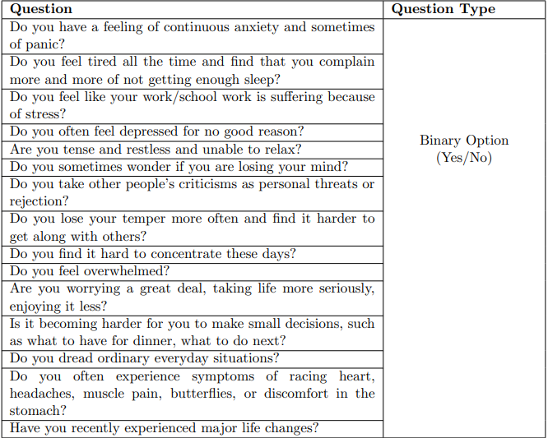
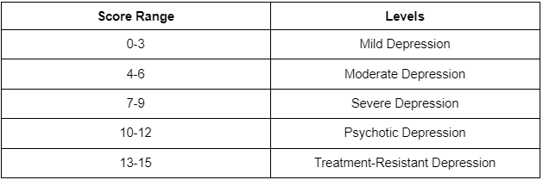
Key Steps of Methodology
Stress Level Mapping
We use 15 score-based stress questionnaire with binary responses to assess stress levels.
The ‘Yes’ and ‘No’ response labeled as 1 and 0.

Slide 8
Key Steps of Methodology
Data Pre-processing
Identifying and handling null values in the dataset
Applying random imputation and sampling techniques
Detecting and managing outliers to enhance the accuracy and consistency of the data.
Converting categorical variables into numerical representations
Summarizing responses to extract key insights
Analyzing categorical data with descriptive statistics to identify key trends

Slide 9
Key Steps of Methodology
Feature Selection
Machine Learning Models
Evaluation Metrics
Applied a 0.12 threshold to retain strongly correlated features and excluding weaker ones.
Splitted data in 80% train and 20% test data.
Explored a diverse set of ML algorithms including Logistic Regression, Random Forest, Gradient Boosting,
Support Vector Machines, Decision Tree, AdaBoost, Naive Bayes
Employed a comprehensive set of metrics , Roc curves to assess the models classification performance : accuracy, precision, F1 score, recall.

Slide 10
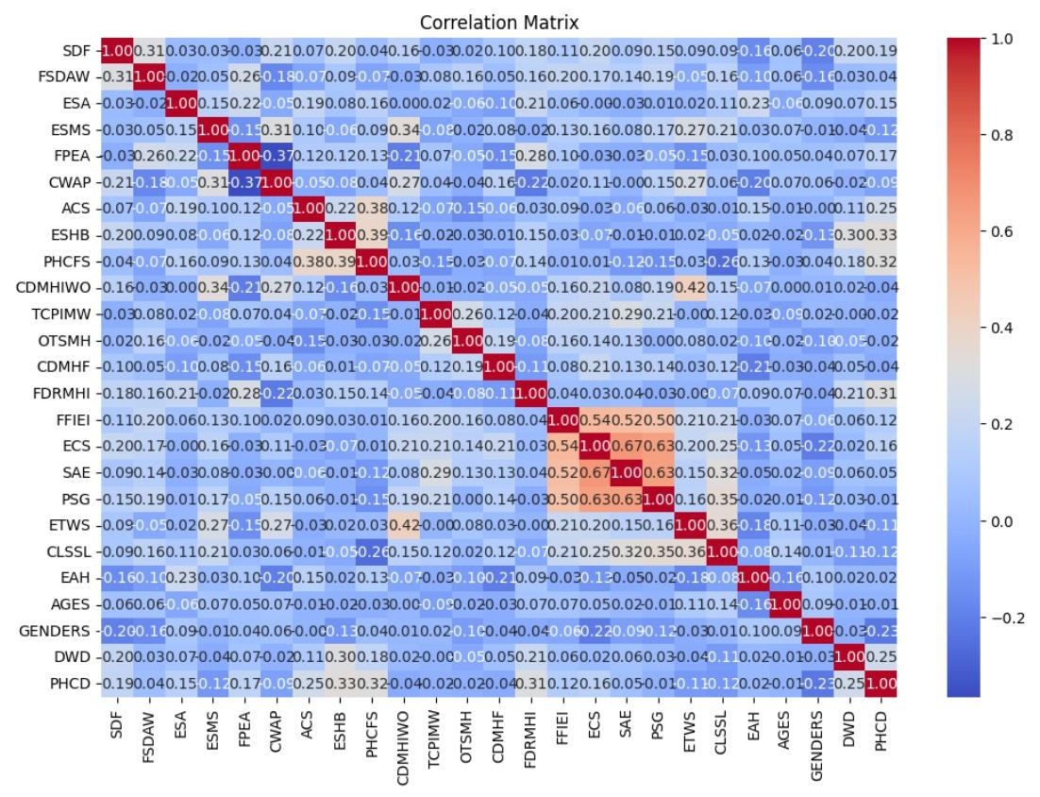
Result Analysis

Slide 11
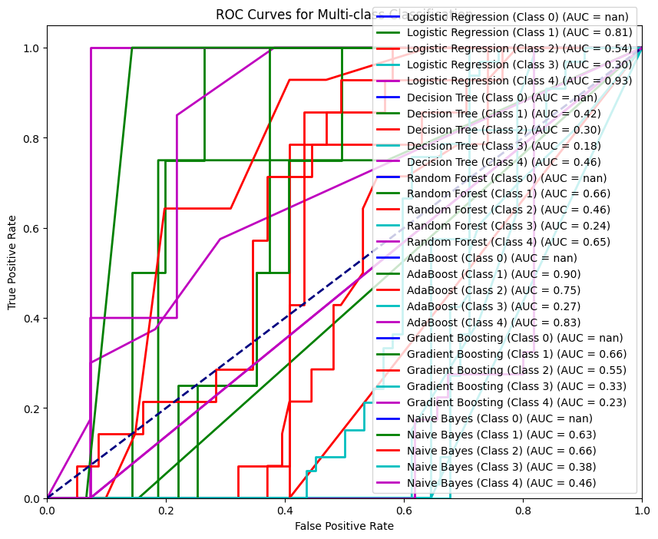
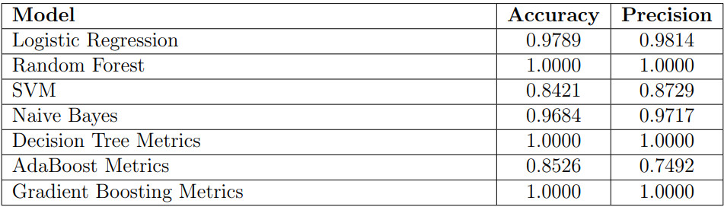
Result Analysis

Slide 12
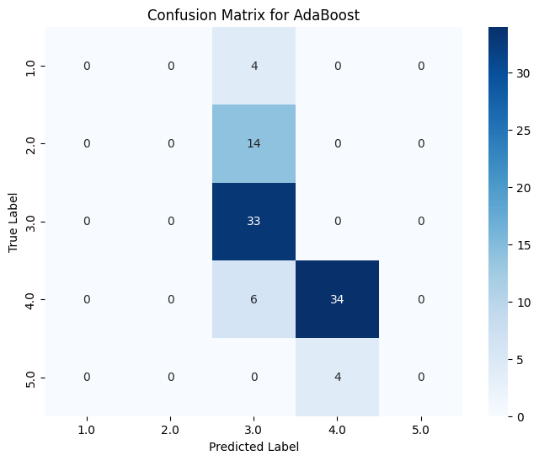
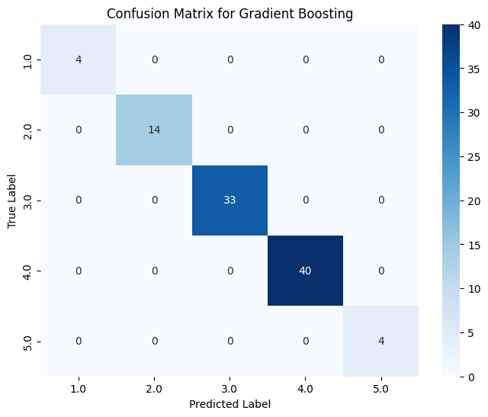
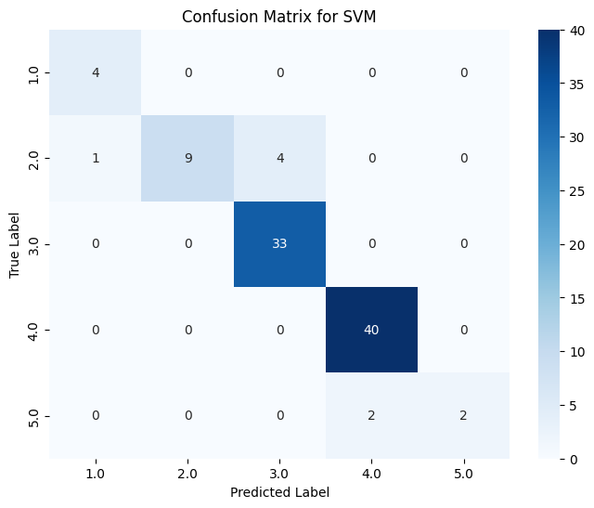
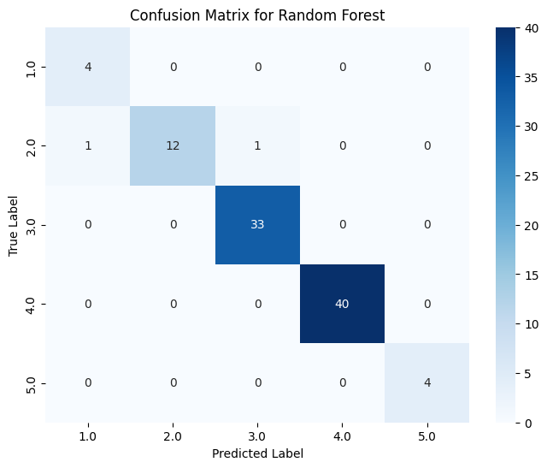

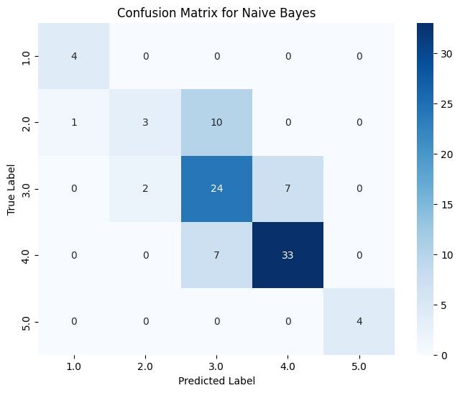
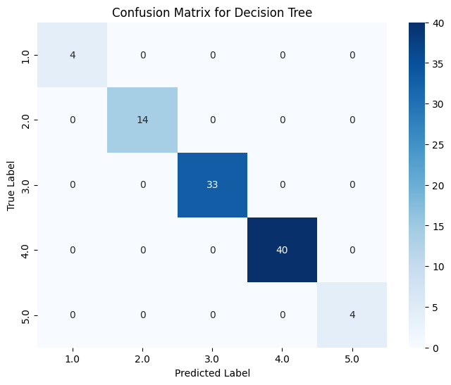
Result Analysis

Slide 13
Chatbot Application Development
Utilizing Flask framework for development
Implementing a pre-trained decision tree model to predict depression severity from user inputs
Enable user interaction via multi-page web forms to collect data on stress and depression factors.
Store data across pages using session objects for a seamless experience.
Map model predictions to categories with descriptions and recommendations.

Slide 14
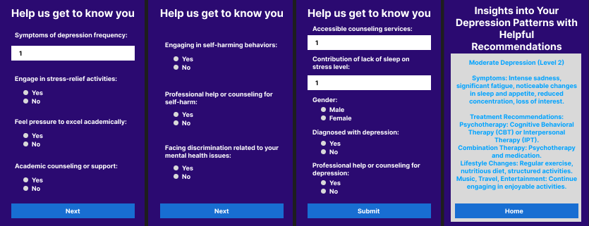
Web App Interface
Preview 1

Slide 15
Conclusion
Contribution
Future Work
Identifies key factors of undergraduate student stress and their mental health impact.
Uses ML algorithms and HCI techniques to analyze stress patterns.
Implements a chatbot for stress management based on depression levels.
Scale dataset to improve model accuracy and performance.
Partner with a diverse group of medical specialists to enhance intervention strategies tailored to individual needs.
Expand parameters and integrate natural language processing (NLP) for more interactive chatbot responses.

Slide 16
References
S. K. Sen, M. S. A. Apurba, P. Mrittika, M. T. Anwar, A. Islam, and J. Noor, “Unveiling shadows: A data-driven insight on depression among bangladeshi university students,” Jannatun, Unveiling Shadows: A Data-Driven Insight on Depression Among Bangladeshi University Students,53
J. M. Burns, T. A. Davenport, L. A. Durkin, G. M. Luscombe, and I. B. Hickie, “The internet as a setting for mental health service utilisation by young people,” Medical Journal of Australia, vol. 192, S22–S26, 2010.
A. Kruisselbrink Flatt, “A suffering generation: Six factors contributing to the mental health crisis in north american higher education.,” College Quarterly, vol. 16, no. 1, n1, 2013.
E. Martinez, C. Ordu, M. R. Della Sala, and A. McFarlane, “Striving to ob-tain a school-work-life balance: The full-time doctoral student,” International Journal of Doctoral Studies, vol. 8, p. 39, 2013.
S. Chancellor, M. L. Birnbaum, E. D. Caine, V. M. Silenzio, and M. De Choud-hury, “A taxonomy of ethical tensions in inferring mental health states from social media,” in Proceedings of the conference on fairness, accountability, and transparency, 2019, pp. 79–88

Slide 17
References
K. Doherty, J. Marcano-Belisario, M. Cohn, et al., “Engagement with men-tal health screening on mobile devices: Results from an antenatal feasibility study,” in Proceedings of the 2019 CHI Conference on Human Factors in Com-puting Systems, 2019, pp. 1–15.
S. Park, J. Choi, S. Lee, et al., “Designing a chatbot for a brief motivational interview on stress management: Qualitative case study,” Journal of medical Internet research, vol. 21, no. 4, e12231, 2019.
C. Pretorius, D. McCashin, N. Kavanagh, and D. Coyle, “Searching for mental health: A mixed-methods study of young people’s online help-seeking,” in Proceedings of the 2020 CHI Conference on Human Factors in Computing Systems, 2020, pp. 1–13
N. Abbas, J. Whitfield, E. Atwell, H. Bowman, T. Pickard, and A. Walker, “Online chat and chatbots to enhance mature student engagement in higher education,” International Journal of Lifelong Education, vol. 41, no. 3, pp. 308–326, 2022.

